Slide 1
Results of a Phase II Trial of
Brentuximab Vedotin As First Line Salvage Therapy in Relapsed/Refractory Hodgkin Lymphoma Prior to Autologous HCT
Abstract 501
Chen R, Palmer J, Martin P, Tsai N-C, Kim Y, Thomas S, Mott M, Sahebi F, Siddiqi T, Armenian S, Shan Y, Popplewell L, Forman S
Notes:
I would like to thank ASH for selecting this abstract for oral presentation. It is my pleasure to share the results of our phase II trial….

Slide 2

Background
20%-30% of Hodgkin lymphoma (HL) patients are refractory/relapsed to induction regimen of ABVD
Standard first-line salvage regimens such as ICE/DHAP/GDP have high response rates but are associated with significant toxicities.
Salvage regimen | N | RR (%) | CR (%) | Grade III/IV AEs
ICE | 65 | 88% | 26% | Thrombocytopenia - 29% Febrile neutropenia - 13% Mobilization failures - 14% PRBC transfusions - 60% Platelet transfusions - 30%
DHAP | 99 | 87% | 21%
GVD | 91 | 70% | 19%
GDP | 34 | 62% | 9%
Josting A, et al. Ann Oncol. 2005;16(1):116-123.
Moskowitz CH, et al. Blood. 2001;97(3):616-623.
Bartlett NL, et al. Ann Oncol. 2007;18(6):1071-1079.
Kuruvilla J, et al. Cancer. 2006;106(2):353-360.
Chen R, et al. Blood. 2014;124: Abstract 501.

Slide 3
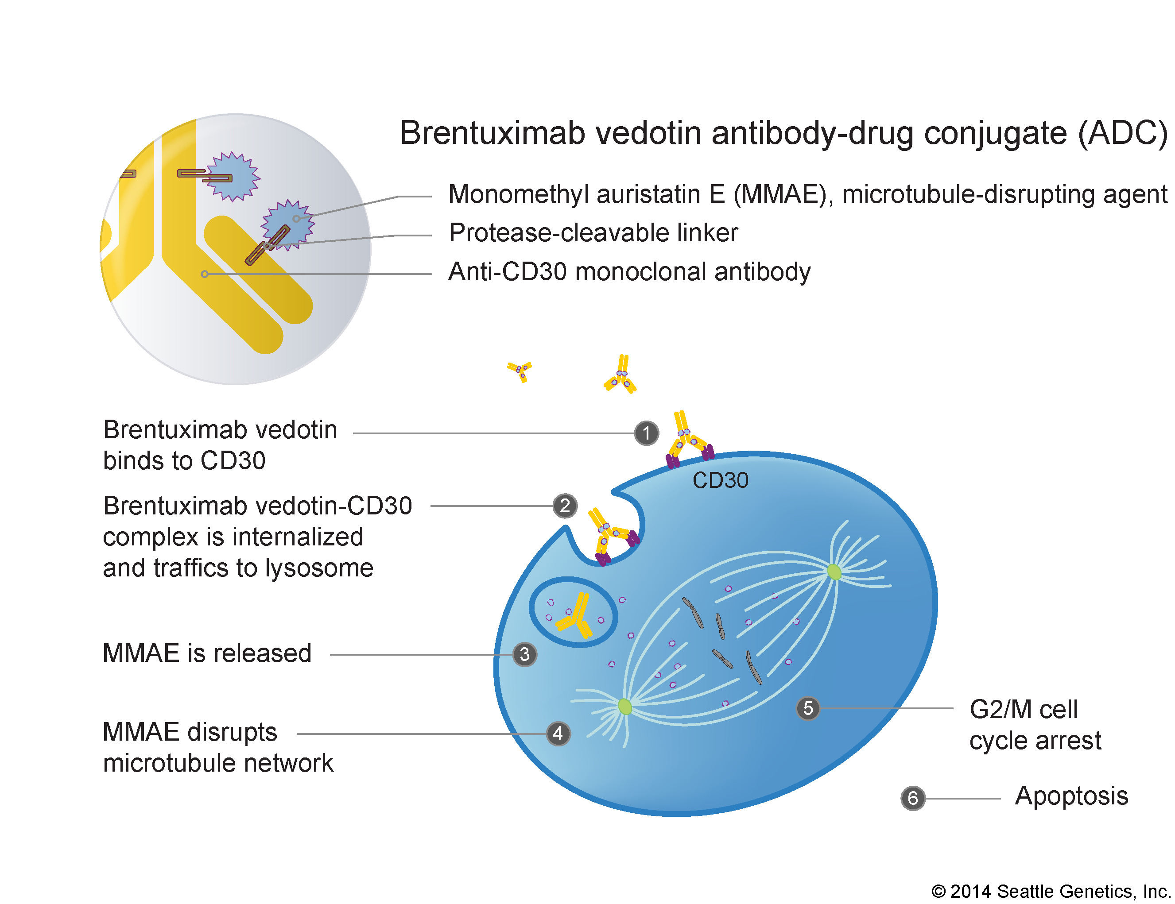
Brentuximab Vedotin
Brentuximab vedotin antibody-drug conjugate (ADC)
Brentuximab vedotin (BV), selectively induces apoptosis of CD30+ cells.
A phase II pivotal trial demonstrated 75% ORR, with 34% CR, and a favorable toxicity profile in HL patients post autologous hematopoietic cell transplantation (AHCT).
We report results of a phase II trial evaluating BV as first line salvage therapy in relapsed or refractory HL prior to AHCT
MMAE, microtubule-disrupting agent
Protease-cleavable linker
Anti-CD30 monoclonal antibody
BV binds to CD30
BV-CD30 complex is internalized and traffics to lysosome
MMAE is released
G2/M cell cycle arrest
MMAE disrupts microtubule network
Apoptosis
MMAE, monomethyl auristatin E (MMAE)
Chen R, et al. Blood. 2014;124: Abstract 501.
Notes:
BV, an antibody drug conjugate, has 3 components. It selectively delivers MMAE to CD 30 + cells

Slide 4
Eligibility Criteria
Inclusion:
Age ≥10 years old
Histologically documented CD30+ HL at relapse
Induction failure (ABVD, BEACOPP, ABVE-PC)
Radiographically measureable disease
Adequate organ functions
Exclusion:
Received second-line salvage therapy
Prior autologous or allogeneic stem cell transplantation
Chen R, et al. Blood. 2014;124: Abstract 501.

Slide 5
Study Schema
BV given at 1.8 mg/kg IV outpatient every 3 weeks for 4 cycles max
No premedication with first cycle
Chen R, et al. Blood. 2014;124: Abstract 501.
Notes:
Pts with relapsed/refractory HL were treated with BV at 1.8 mg/kg IV at oupt setting every 3 weeks.

Slide 6
Study Design
Prospective multicenter phase II study
Primary endpoint – overall response rate (ORR – CR + PR)
Secondary endpoints: toxicity, stem cell mobilization rate, engraftment, biomarker assessment
Simon optimal two-stage design used to assess ORR
First stage, 12/23 patients must achieve CR or PR to continue
Second stage, accrue up to 37 patients, with 23 or more responses regarded as sufficient to warrant further investigation.
Target response rate is 60%
Two-sided test at the P = .05 significance provides 80% power
Toxicity was assessed and graded using the NCI CTCAE v4.03
Chen R, et al. Blood. 2014;124: Abstract 501.

Slide 7
Baseline Patient Characteristics
Characteristics | N (%) or Median (Range)
Age | 34 (11-67)
Institution City of Hope Weill Cornell | 31 (84%) 6 (16%)
Stage at Diagnosis I-II III-IV | 19 (51%) 18 (49%)
B symptoms | 23 (62%)
Bulky Disease (> 5 cm) | 32 (86%)
Induction Chemotherapy ABVD ABVD/BEACOPP ABVE-PC | 34 2 1
Prior XRT | 9 (24%)
Best Response to Induction Primary Refractory Relapsed (within 7 months) | 24 (65%) 13 (35%)
Chen R, et al. Blood. 2014;124: Abstract 501.
Notes:
Talk about high risk features. Bulky, B sx, primary refractory

Slide 8
Response Rate
37 accrued, 37 eligible for toxicity evaluation, 36 eligible for response evaluation
 | Best Response | Best Response at Cycle 2 | Response at Cycle 4 or EOT
ORR | 25/36 (69%) | 24/36 (67%) | 22/36 (61%)
CR | 13/36 (36%) | 13/36 (36%) | 13/36 (36%)
PR | 12/36 (33%) | 11/36 (31%) | 9/36 (25%)
SD | 10/36 (28%) | 11/36 (31%) | 10/36 (27%)
PD | 1/36 (3%) | 1/36 (3%) | 4/36 (11%)
Univariate analysis: no differences in terms of age, sex, disease stage, response to induction, bulky disease, or B symptoms.
Chen R, et al. Blood. 2014;124: Abstract 501.

Slide 9
Heme AE, Non Hem AE Occurred >15%, All Grade III-IV
Adverse Event | Grade 1 | Grade 2
Anemia | 16% | 3%
Neutropenia | 11%
Thrombocytopenia | 8%
Lymphopenia |  | 3%
Peripheral neuropathy | 49% | 3%
AST elevation | 32% | 5%
ALT elevation | 27% | 11%
Rash (new) | 24% | 11%
Muscle weakness | 24% | 5%
Hypoglycemia | 22%
Fatigue | 19% | 11%
Pruritis | 19% | 3%
Nausea | 16% | 3%
Abdominal Pain | 11% | 5%
Adverse Event | Grade 3 | Grade 4
Anemia | 0%
Neutropenia | 5%
Thrombocytopenia
Lymphopenia | 3% | 3%
AST elevation | 3%
Hyperuricemia |  | 3%
Tumor lysis syndrome | 3%
Rash (new) | 5%
Pruritis | 3%
Creatinine elevated | 3%
No Growth Factor, PRBC,
or PLT transfusions
Chen R, et al. Blood. 2014;124: Abstract 501.

Slide 10
AHCT
33/37 successfully proceeded to AHCT (89%): 1 went to allo-HCT; 3 could not be salvaged
17/33 (52%) received BV only
16/37 (48%) received additional salvage chemotherapy (ICE/DICE/IGEV/GVD)
13 CR and 4/12 PR went to AHCT directly
24/33 (73%) were in CR at time of AHCT
8/33 (26%) were in PR at time of AHCT
1/33 SD at time of AHCT
Chen R, et al. Blood. 2014;124: Abstract 501.

Slide 11
Stem Cell Mobilization
Patients were primed with G-CSF/cyclophosphamide/plerixafor
Characteristics | N (%) or Median (Range)
Cell count | 5.97 x 10⁶ CD 34 (2.64-34.45)
Days required for collection | 2 (1-6)
Plerixafor usage | 9 (27%)
ANC engraftment | 11 (10-12)
Platelet engraftment | 13 (9-23)
Chen R, et al. Blood. 2014;124: Abstract 501.
Notes:
Stem cell mobilization and engraftment were not adversely affected

Slide 12
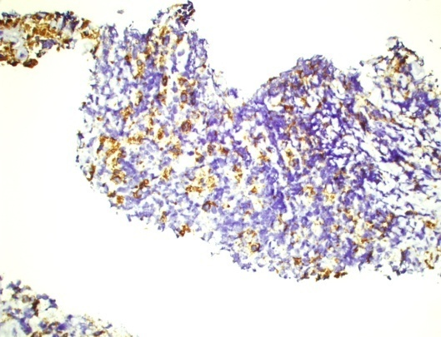
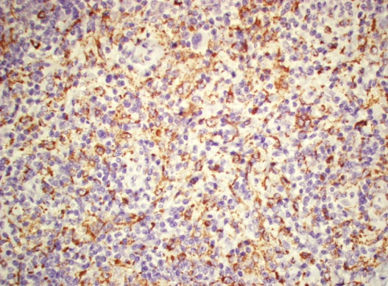
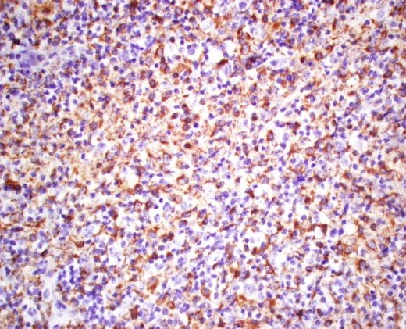
Biological Correlatives
CD 68 macrophages associated with failure to induction ABVD
Performed IHC staining on COH samples prior to BV treatment
All COH samples were CD 68+
2+ (31%)
3+ (62%)
4+ (6%)
CD 68 does not appear to be associated with outcome for BV
2 +
3 +
4 +
Steidl C, et al. N Engl J Med. 2010;362(10):875-885.
Chen R, et al. Blood. 2014;124: Abstract 501.
Notes:
In this study, we examined whether or not CD 68 macrophages is a predictor marker for response to BV.
Although CD 68 is a predictive biomarker for ABVD in HL, it does not appear to be associated with outcome for BV.

Slide 13
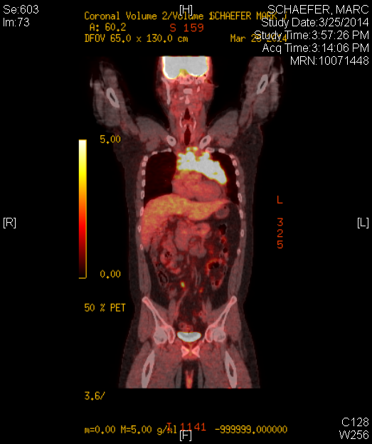
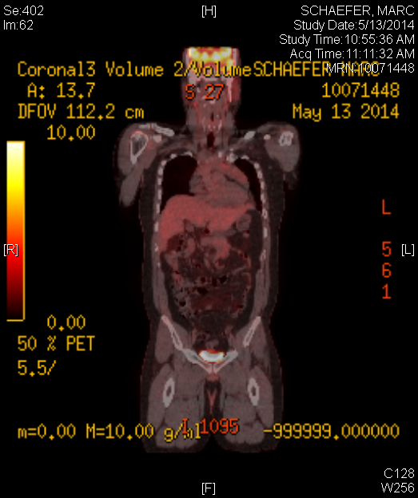
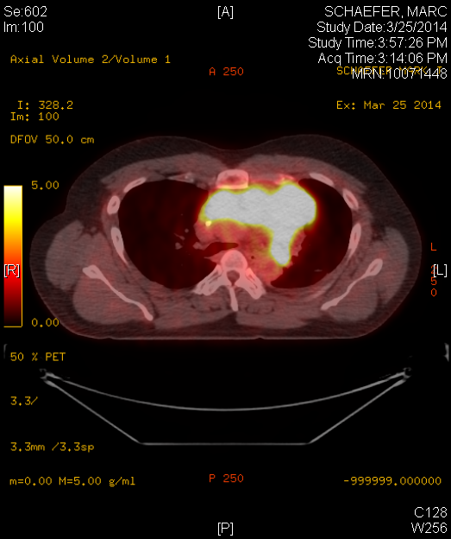
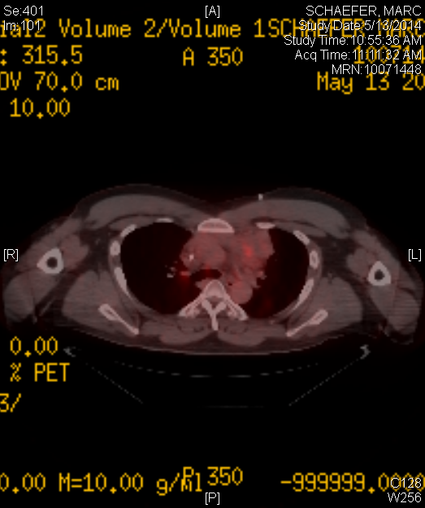
Patient Case, CR
30-year-old male
Stage IVB
Bulky disease
ABVD x 6
No XRT
Relapse 4 month
Baseline Cycle 2
Chen R, et al. Blood. 2014;124: Abstract 501.
Notes:
I am going to show you two cases of the pt on study.

Slide 14
Summary/Conclusion
ORR 69%, CR 36%
Toxicity profile well tolerated
Patients required no growth factor support, PRBC, or platelet transfusions
89% went to AHCT successfully, 52% went to AHCT without additional salvage chemotherapy
Stem cell mobilization and engraftment not affected
For patients with relapsed/refractory HL after induction chemotherapy, BV can be considered as first-line salvage therapy
Risk of progression for patients not achieving CR after 2 cycles
Chen R, et al. Blood. 2014;124: Abstract 501.

Slide 15
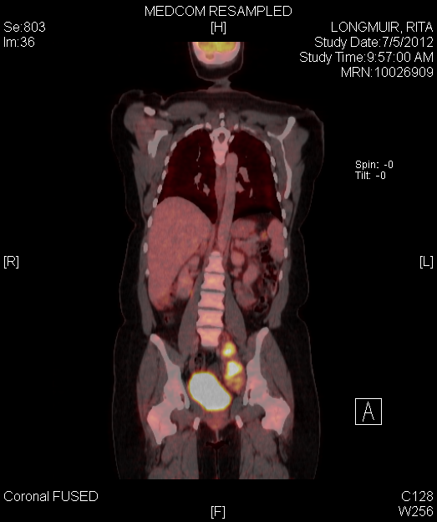
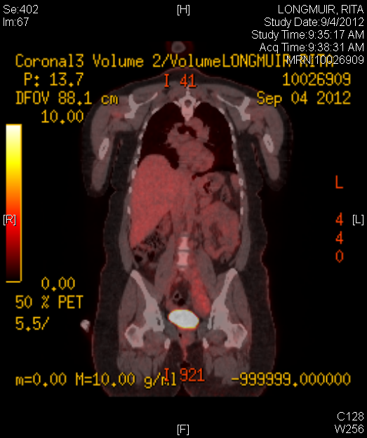
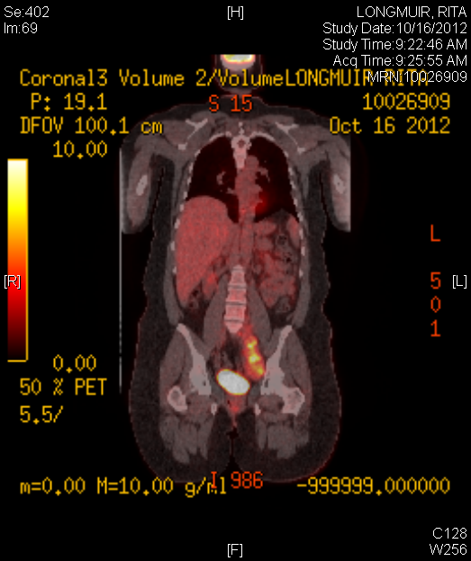
Patient Case, Progression
Baseline Cycle 2 Cycle 4
45 female
Stage IIB, Bulky disease
ABVD x 6 cycle, no XRT
Primary refractory
Chen R, et al. Blood. 2014;124: Abstract 501.

Slide 16
Amendment
BV dose increased from 1.8 mg/kg to 2.4 mg/kg after 2nd cycle for patients not achieving CR.
Chen R, et al. Blood. 2014;124: Abstract 501.

